Slide 1

Chapter 5: Calculating chemical quantities

Slide 2
Relative mass of atoms and substances
Relative molecular mass M_{r}
Relative atomic mass A_{r}
is the mass of an atom relative to that of a carbon-12 atom.
is the mass on one molecule of the substance relative to that of a carbon-12 atom
It is the sum of the relative atomic masses as given by the molecular formula.

Slide 3
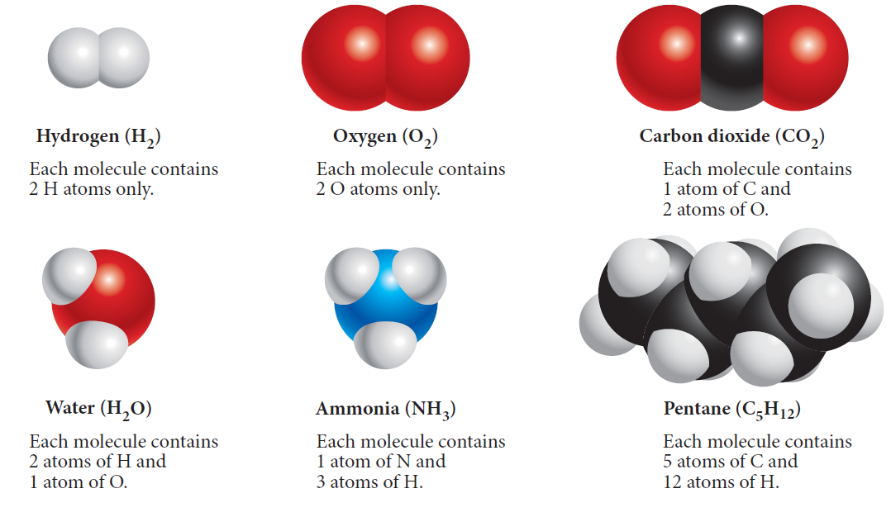
Examples of molecules

Slide 4
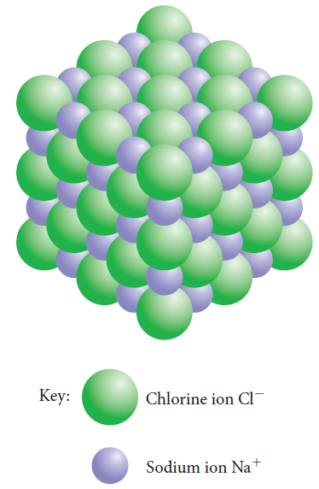
Relative formula mass M_{r}
The relative formula mass of a compound (M_{r}) is the sum of the relative atomic
masses of the atomic species as given by the formula of the compound.
It is used for ionic compounds.

Slide 5
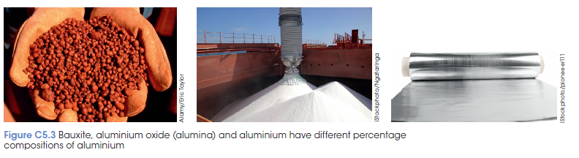
Percentage composition
is the percentage by mass of each of the
different elements in the compound
Can be calculated from the chemical formula and the relative atomic masses of the elements.

Slide 6
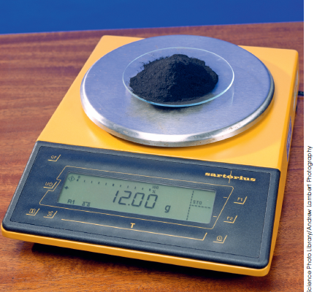
The Avogadro constant and the mole
The Avogadro constant (N_{A}) is the number of atoms (6.02 x 10²³) in exactly
12 grams of the carbon-12 isotope.
As elements always have the same mass ratio this enables the determination of the number of particles.

Slide 7
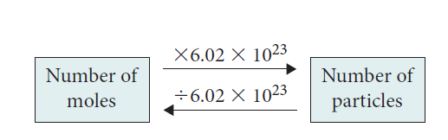
Avogadro constant and the mole
Avogadro constant is a scaling factor between the macroscopic and atomic scale.
A mole is the amount of substance mole is the amount of substance containing 6.02 x 10²³ particles of that substance.

Slide 8
The mole (mol) is represented by the symbol n
Number of moles(n) = number of particles
number of particles per mole N_{A}
n = number of particles
6.02 x10²³

Slide 9
Worked example
How many moles of magnesium are there in 1.45 x 10²³ atoms of magnesium?
n(Mg) = 1.45 x 10²³
6.02 x 10²³
= 0.24 mol

Slide 10
Mole and chemical formula
Using the relationship between mole and the Avogadro constant the number of individual atoms can be calculated.
Molecular formula of water (H₂O) shows 2 atoms of hydrogen and one atom of oxygen.
In one mole of water molecules must have two moles of hydrogen and one mole of oxygen atoms.
This also applies to ionic compounds (formula units).

Slide 11
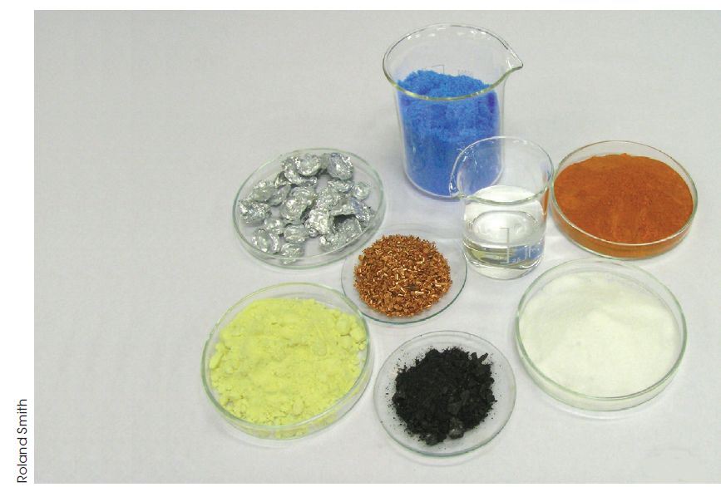
Moles and mass
One mole of any substance has a mass equal to the relative atomic, molecular or formula mass of that substance expressed in grams.
The mass of 1 mol = molar mass, symbol M
Units: grams per mole

Slide 12
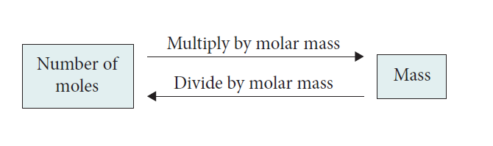
Converting between moles and mass
Number of mole = _____mass (g)___
molar mass (g mol⁻¹)

Slide 13
Empirical and molecular formulas
The empirical formula of any compound is the simplest whole number ratio of the atoms.
For an ionic compound, this is the formula.
The molecular formula is the actual number of each type of atom present in the molecule.
It is often different to the empirical formula for molecular substances.
Notes:
Empirical formula are determined by experimentation.

Slide 14
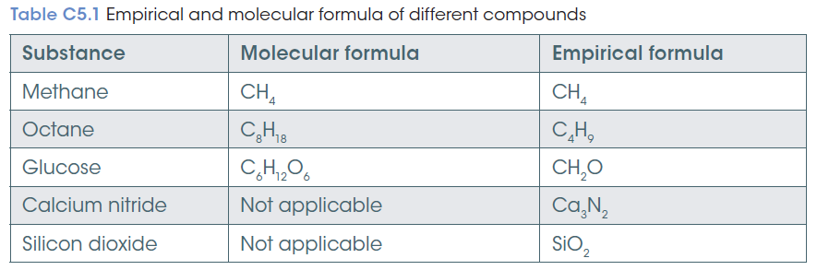

Slide 15
Chemical equations, moles and mass
Stoichiometry
Knowing the number of moles of any species and the balanced equation the number of moles of the other species can be determined.
The coefficients in the balanced equations represent the relationship between the number of reactant and product particles.
The coefficients give the molar ratio of the reaction.

Slide 16
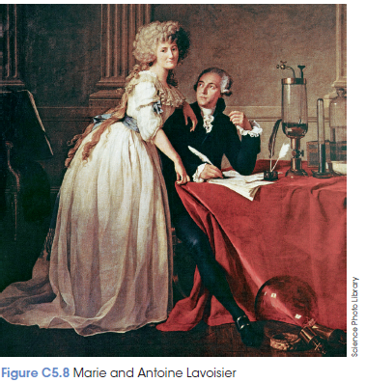
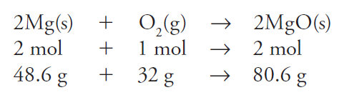
Mass and chemical equations
The law of conservation of mass states that in a chemical reaction, mass is neither created nor destroyed.
The total mass of the products
equals the total mass of
Reactants.

Slide 17
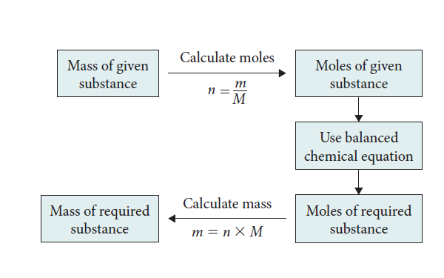
Mass–mass calculations
Mass of a known substance and a balanced chemical equation can calculate the mass of all other species involved in the reaction.

